Slide 1
Lesson 14
Verification & Validation

Slide 2
Assembly, Integration, and Test (AIT)
Assembly
Integration
Test
Notes:
Assembly
Definition: The process of physically building and connecting spacecraft components (mechanical, electrical, and electronic parts) into subsystems and then into the complete spacecraft.
Goal: Ensure all hardware elements are correctly installed, mechanically secured, and electrically connected according to engineering drawings and specifications.
Example: Mounting solar panels, bolting reaction wheels, soldering harnesses, or installing avionics boards.
Integration
Definition: The process of combining subsystems—such as power, communications, ADCS, and payload—into a complete, functioning spacecraft system.
Goal: Verify that subsystems interface and communicate correctly, both electrically and through software.
Example: Connecting the avionics bus to the power subsystem and verifying telemetry and command flow.
Testing
Definition: The structured set of activities used to verify and validate that the assembled and integrated spacecraft meets its design requirements and can survive the space environment.
Goal: Identify defects, confirm performance, and certify the spacecraft as flight-ready.
Includes:
Functional tests: Check subsystem operations.
Performance tests: Measure design specs (power draw, data rate, torque output).
Environmental tests: Simulate launch and space conditions (vibration, thermal-vacuum, EMI/EMC).
Qualification vs. Acceptance testing: Design-level vs. flight-unit validation.

Slide 3
Steps in Design, Manufacturing, AIT
Prepare Engineering Data
ICDs, Specifications, drawings, schematics, processes needed to fabricate a part or component
Fabrication/Manufacturing
Turn Engineering Data into a part or component
Develop assembly, testing procedures
Assemble parts into components
Assemble components into assemblies
Integrate assemblies to create whole S/C
Verification/Testing
Done throughout
Notes:
The Interface Control Document (ICD) describes the interfaces between two systems. It should include
all interfaces the system has with other systems. It can be either hardware or software. Some examples
are:
• Bolt locations
• Purpose of each wire in a connector
• All possible commands that may be sent/received
• Units of values
• Thousands of more possibilities
If the engineer cannot build the system to meet the interface definitions, all affected systems must meet
and agree on any changes that are made.

Slide 4
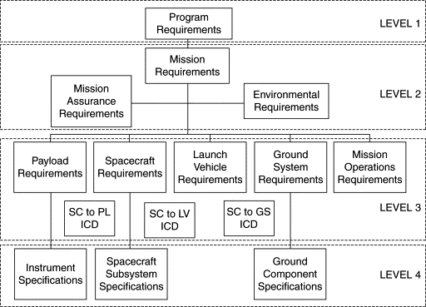
Requirements Flowdown
Notes:
The Interface Control Document (ICD) describes the interfaces between two systems. It should include
all interfaces the system has with other systems. It can be either hardware or software. Some examples
are:
• Bolt locations
• Purpose of each wire in a connector
• All possible commands that may be sent/received
• Units of values
• Thousands of more possibilities
If the engineer cannot build the system to meet the interface definitions, all affected systems must meet
and agree on any changes that are made.

Slide 5
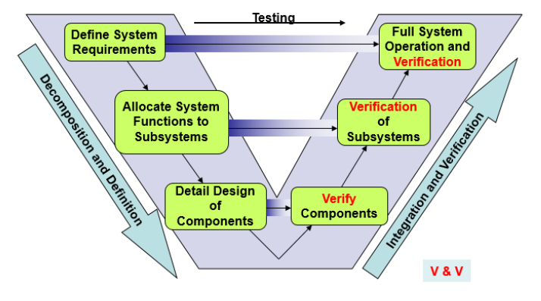
Systems Engineering “V” Model

Slide 6
Definitions
Verification: process that proves that a realized product conforms to its requirements
Asks the question: “Did we build the thing right?”
Validation: process that confirms that the realized end products conform to stakeholder expectations
Asks the question: “Did we build the right thing?”
Key Differences:
Verification derives test standards from requirements document
Validation derives test standards from CONOPS document
Notes:
Verification
Definition: The process of determining whether the system was built correctly — i.e., does it meet its specified requirements?
Question it answers:
“Did we build the system right?”
Purpose: To ensure the spacecraft’s design and implementation satisfy all technical and performance requirements.
Validation
Definition: The process of determining whether the right system was built — i.e., does it fulfill the mission’s intended purpose and stakeholder needs?
Question it answers:
“Did we build the right system?”
Purpose: To ensure the spacecraft performs correctly in its operational context (mission environment, user expectations, goals).
Validation Activities
Conducted late in development or during early operations.
Confirm that the integrated spacecraft meets mission-level objectives.
Examples:
End-to-end communication test from ground to spacecraft.
Imaging the Earth to confirm payload performance matches science goals.
Functional rehearsal of a deployment sequence in relevant environment.\
Takeaway
Verification ensures the spacecraft meets its design specifications.
Validation ensures it meets its mission purpose.
Both are essential for mission assurance and are formally tracked in a V&V matrix, which maps requirements to test or analysis results.

Slide 7
Verification Process
Objective: to generate evidence necessary to confirm that end products, from the lowest level of the system structure to the highest, conform to the specified requirements.
Key Outputs:
Discrepancy reports and identified corrective actions
Verified product to validation or integration
Verification report and any required updates to requirements/compliance documentation
Success criteria:
Documented objective evidence of compliance (or waiver, as appropriate) of each requirement
Closure of all discrepancy reports

Slide 8
Verification Methods
Four verification methods:
Demonstration: showing that use of product achieves requirement
Used for requirements that do not require intense data gathering (“shall be able to rotate 90 degrees”)
Test: obtaining detailed performance data
Most requirements
Analysis: use of modeling & simulation
Often used for ADCS, Structures and TCS
Inspection: e.g. visual examination
Used to verify simple requirements (“shall have an RBF tag”)
*Can use a combination of verification methods to verify a requirement
eg: Structures performs static loading, vibe and acoustic tests and then correlates those results back to detailed models
Notes:
1. Test
Definition: Physically demonstrating that a hardware or software item meets its requirement by direct measurement or observation under controlled conditions.
Purpose: Provides the most conclusive verification.
Examples:
Thermal-vacuum test to verify operation in space conditions.
Vibration test to verify launch survivability.
Software test executing command sequences.
2. Analysis
Definition: Using analytical or computational models to demonstrate compliance when physical testing is impractical or unnecessary.
Purpose: Verify performance using validated simulations or calculations.
Examples:
Structural finite element analysis (FEA) for stress verification.
Thermal modeling to confirm temperature margins.
RF link budget analysis to verify communications performance.
3. Inspection
Definition: Physically examining or measuring hardware to verify it meets requirements such as materials, dimensions, workmanship, or labels.
Purpose: Simple and quick verification of tangible properties.
Examples:
Checking part numbers and serial tags.
Measuring connector pin alignment or coating thickness.
Verifying presence of required components or safety features.
4. Demonstration
Definition: Showing that an item performs its intended function in a controlled, observable environment, often without full instrumentation or formal data collection.
Purpose: Verify functional or operational capabilities by example.
Examples:
Deploying solar panels in 1-g test setup.
Demonstrating command and telemetry sequences on a flatsat.
Power-on check for basic system functionality.

Slide 9
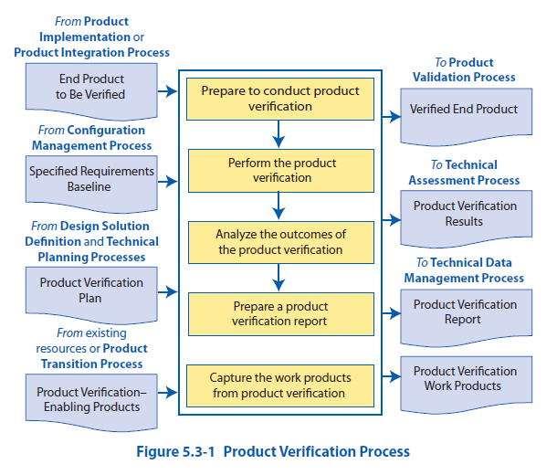

Slide 10
Steps of the Verification Process (1/2)
Step | Outcomes
1. Verification Planning | - Verification method(s) for each requirement is/are selected - Procedures for each type of verification are written & success criteria is clear - Facilities/test equipment are available (vibe table, TVAC chamber, etc.)
2. Verification Preparation | - Requirements for the product are identified - Test articles are identified and ready (don’t always test flight unit, can test engineering units)
3. Conduct Verification | - Verification data is collected for each requirement - (Initial) determination about whether the product meets all requirements (may require further analysis to be sure)

Slide 11
Steps of the Verification Process (2/2)
Step | Outcomes
4. Analyze Verification Results | - Anomalies or out-of-compliance conditions identified - Determination on discrepancies (waiver, re-test, re-work, etc.) -Corrective actions (as required)
5. Capture Verification Work Products | - Verification report is developed and includes: Assumptions Set of requirements to be verified Test description, details on test configuration Test data Results of each requirement verification, including pass/fail adjudication Comments on anomalies, corrective actions Lessons learned - Complete any other supporting documentation

Slide 12
Testing

Slide 13
Definitions
Engineering Model / Test Unit: representative, testable version of hardware.
Flight Unit: Hardware that flies.

Slide 14
Test Levels
Unit Test
Subsystem Test
Vehicle Test
Notes:
Unit Test: testing a component before it is integrated into subsystem, to ensure it works as expected and meets all unit-level requirements
Note: we expect that suppliers of piece parts test individual piece parts before sending to the contractor to build, so “unit test” refers to tests at the component level
Subsystem Test: testing a subsystem before it is integrated into the vehicle, to ensure all components work together as expected to meet subsystem-level requirements
Vehicle Test: testing all subsystems together, to ensure they all work together as expected across range of requirements

Slide 15
Test Categories
Functional: demonstrates all functional capabilities expected from an article (unit, subsystem, vehicle); ie, gives expected telemetry, receives expected commands, etc.
Acceptance: demonstrates acceptability of each deliverable item to meet performance specification and demonstrate error-free workmanship in manufacturing
Lowest test level, required by all flight items
Meets all requirements over expected ranges (temperatures, stress, etc)
Qualification: demonstrates that the design, manufacturing process and acceptance program produce hardware/software that meet specification requirements with adequate margin
Most stringent test level, ensures that units will remain flight-worthy after surviving multiple acceptance tests
Meets all requirements beyond expected ranges, intended to stress items
Typically performed on test units, rather than flight units
Protoqualification: hybrid of qualification and acceptance testing; applies reduced qualification-level testing to hardware
Middle test level, would replace qualification
Uses flight units for testing
Compromise for qualification testing, when it is not practical/affordable to have a full engineering model to qualification test
First unit is put through protoqualification test levels, subsequent vehicles are just acceptance tested (sometimes called “qualification by similarity”)
Notes:
Functional: demonstrates all functional capabilities expected from an article (unit, subsystem, vehicle); ie, gives expected telemetry, receives expected commands, etc.
Acceptance: demonstrates acceptability of each deliverable item to meet performance specification and demonstrate error-free workmanship in manufacturing
Lowest test level, required by all flight items
Meets all requirements over expected ranges (temperatures, stress, etc)
Qualification: demonstrates that the design, manufacturing process and acceptance program produce hardware/software that meet specification requirements with adequate margin
Most stringent test level, ensures that units will remain flight-worthy after surviving multiple acceptance tests
Meets all requirements beyond expected ranges, intended to stress items
Typically performed on test units, rather than flight units
Protoqualification: hybrid of qualification and acceptance testing; applies reduced qualification-level testing to hardware
Middle test level, would replace qualification
Uses flight units for testing
Compromise for qualification testing, when it is not practical/affordable to have a full engineering model to qualification test
First unit is put through protoqualification test levels, subsequent vehicles are just acceptance tested (sometimes called “qualification by similarity”)
----------------------------------------------------------------------------------------------------------------------------------------------------------------------------------------------------
Acceptance Testing
Purpose: To prove the workmanship — confirm that each flight unit (the actual spacecraft to be launched) was built and assembled correctly.
Scope: Conducted on flight hardware.
Stress Level:
Tests are run at nominal mission levels (not as severe as qualification).
Ensures the flight unit is free from defects introduced during manufacturing or assembly.
Outcome:
Confirms the flight article is ready for launch.
Any test failures trigger rework and retesting of that specific unit.
🛰️ Example: An acceptance-level thermal-vacuum test might cycle between +60°C and –30°C for three orbits, verifying performance under normal mission extremes.
Qualification Testing
Purpose: To prove the design — demonstrate that the spacecraft’s design, materials, and manufacturing processes can survive and perform under the worst-case environmental and operational conditions expected during its mission.
Scope: Conducted on qualification hardware (non-flight or prototype units).
Stress Level:
Test levels and durations are typically higher than flight levels (e.g., +25% vibration amplitude or extended thermal cycles).
Ensures margin and robustness in the design.
Outcome:
Confirms the design is sound and the spacecraft can handle its mission environment.
Once qualified, the same design can be reused for future builds.
🛰️ Example: A qualification vibration test may run at 12 g RMS for 3 minutes per axis — higher than the 8 g RMS expected for launch.

Slide 16
Life of a Test
Common milestones of a test campaign:
Test planning and preparation
Kickoff meeting, Test Concept Review (TCR), Test Design Review (TDR)
Test Readiness Review (TRR)
Formal checkpoint to confirm that the test setup, hardware, and personnel are ready to proceed safely and correctly.
Test Execution
Analysis / Test Report
Anomaly Resolution & Re-Test (if needed)
Closeout → All test results reviewed and approved
Notes:
1. Test Planning & Preparation
Purpose: Define what will be tested, how, and by whom.
Key Activities:
Develop Test Plan and Test Procedures.
Identify requirements to be verified.
Prepare test configurations, hardware, and instrumentation.
Schedule facility time (e.g., vibration table, thermal-vac chamber).
Deliverables: Draft Test Plan, Equipment Lists, Review data packages.
2. Test Readiness Review (TRR)
Purpose: Formal checkpoint to confirm that the test setup, hardware, and personnel are ready to proceed safely and correctly.
Key Questions:
Is the test article properly configured?
Are procedures and safety controls in place?
Are required resources and personnel available?
Outcome: Authorization to begin testing.
3. Test Execution
Purpose: Perform the test according to approved procedures.
Steps:
Pre-test setup and calibration.
Execute the test sequence (functional, performance, or environmental).
Record data and monitor real-time telemetry for anomalies.
Considerations:
Any test deviation or anomaly must be documented and approved before continuation.
4. Test Data Review
Purpose: Verify data completeness, accuracy, and consistency.
Activities:
Post-test data reduction and plotting.
Compare measured results to acceptance or qualification criteria.
Identify any out-of-family results.
5. Test Report / Test Summary
Purpose: Document the results and confirm compliance with requirements.
Contents:
Test setup and configuration.
Procedures and deviations.
Results, plots, and analysis.
Conclusions (Pass/Fail).
Outcome: Final archived report for configuration and verification tracking.
6. Anomaly Resolution & Re-Test (if needed)
Purpose: Address issues or failures found during testing.
Activities:
Root-cause analysis and corrective action.
Repeat tests or partial re-tests if needed.
Deliverable: Corrective Action Report and closure documentation.
7. Test Review Board / Test Closeout
Purpose: Formally close the test activity and update the Verification & Validation (V&V) Matrix.
Outcome:
All test results reviewed and approved.
Test item cleared for next integration level or for flight.

Slide 17
Test Types

Slide 18
Specification Performance (“Full Functional”) Test
Verifies that the mechanical and electrical performance of the vehicle meets requirements
Including compatibility with GSE (ground support equipment)
Confirms all test software and techniques work
Demonstrates operation of all redundant units

Slide 19
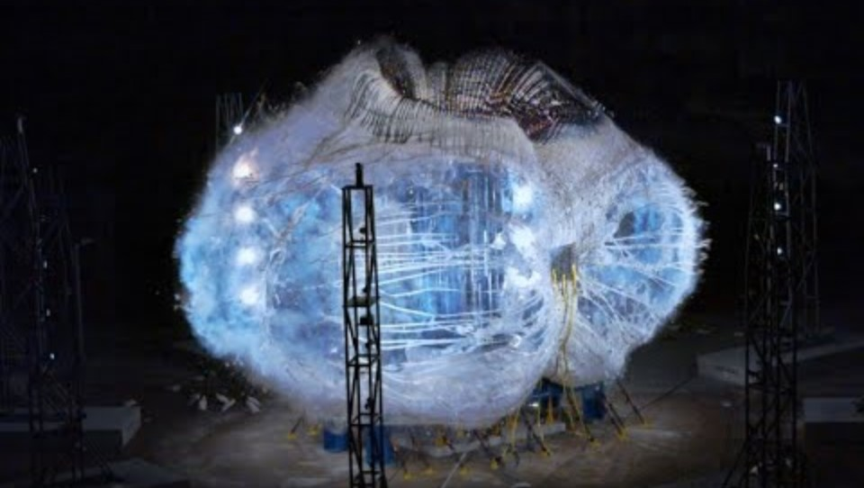
Pressure and Leakage Tests
Demonstrate the capability of pressurized subsystems to meet specified flow, pressure and leakage rate requirements

Slide 20
Electromagnetic Interference & Compatibility (EMI & EMC) Testing
Demonstrates electromagnetic compatibility of vehicle to operating environment
Launch is bigger concern – both LV and ground communicating w/ LV, on-orbit operations have less interference
Two types
1. Emissions:
Conducted
Radiated
2. Susceptibility:
Conducted and Radiated. Tested by having expected radio frequencies (from LV or ground) radiated at vehicle while performing nominal operations.
Notes:
Test facility: RF or anechoic chamber
Objectives
Verify S/C is not susceptible to (is compatible with) RF energy emitted by LV (and the opposite)
Two major types
1. Conducted & Radiated Emissions:
Conducted: consists of electromagnetic interference in circuits that could create issues in delivered power quality due to interference caused by harmonics due to linear and non-linear loads present in the electrical power subsystem and harnessing
Radiated: comes from antenna when it produces its waveform
2. Conducted & Radiated Susceptibility: ability of a system to operate acceptably when subjected to electromagnetic interference (conducted) and radio frequency voltage or current (radiated)
Tested by having expected radio frequencies (from LV or ground) radiated at vehicle while performing nominal operations

Slide 21
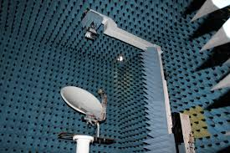
Anechoic Chamber
Notes:
An anechoic chamber is a specially designed room that absorbs electromagnetic waves or sound waves, preventing reflections from walls, ceiling, and floor so that measurements can be made in a reflection-free environment.
In space systems and avionics testing, an anechoic chamber is typically used for RF testing.
Purpose: Create an environment that simulates free space, allowing engineers to accurately measure antennas, radios, and electromagnetic emissions.
Typical tests include:
Antenna radiation patterns
Gain measurements
Satellite communication antennas
Radar cross-section testing
EMI/EMC testing

Slide 22
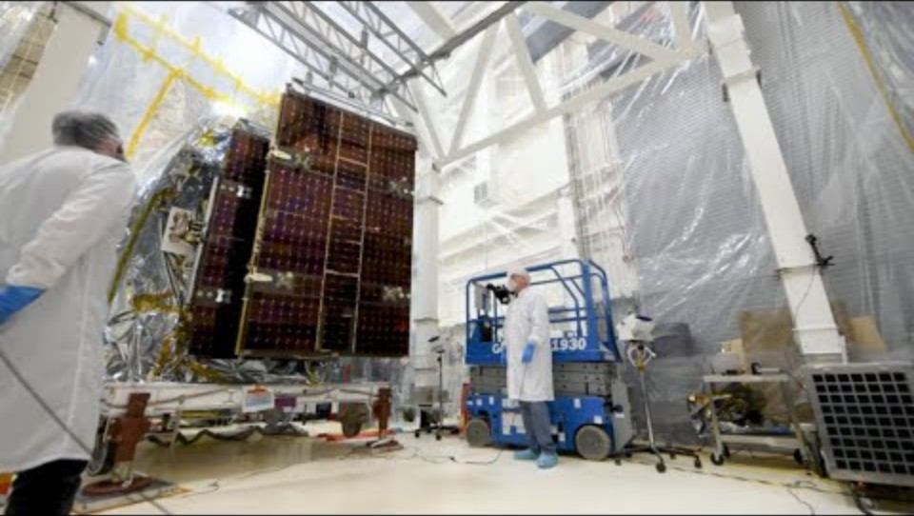
Deployment Testing
Demonstrates the capability of the vehicle to withstand induced shock environments (ie, launch vehicle separation, solar array deployment, etc)

Slide 23
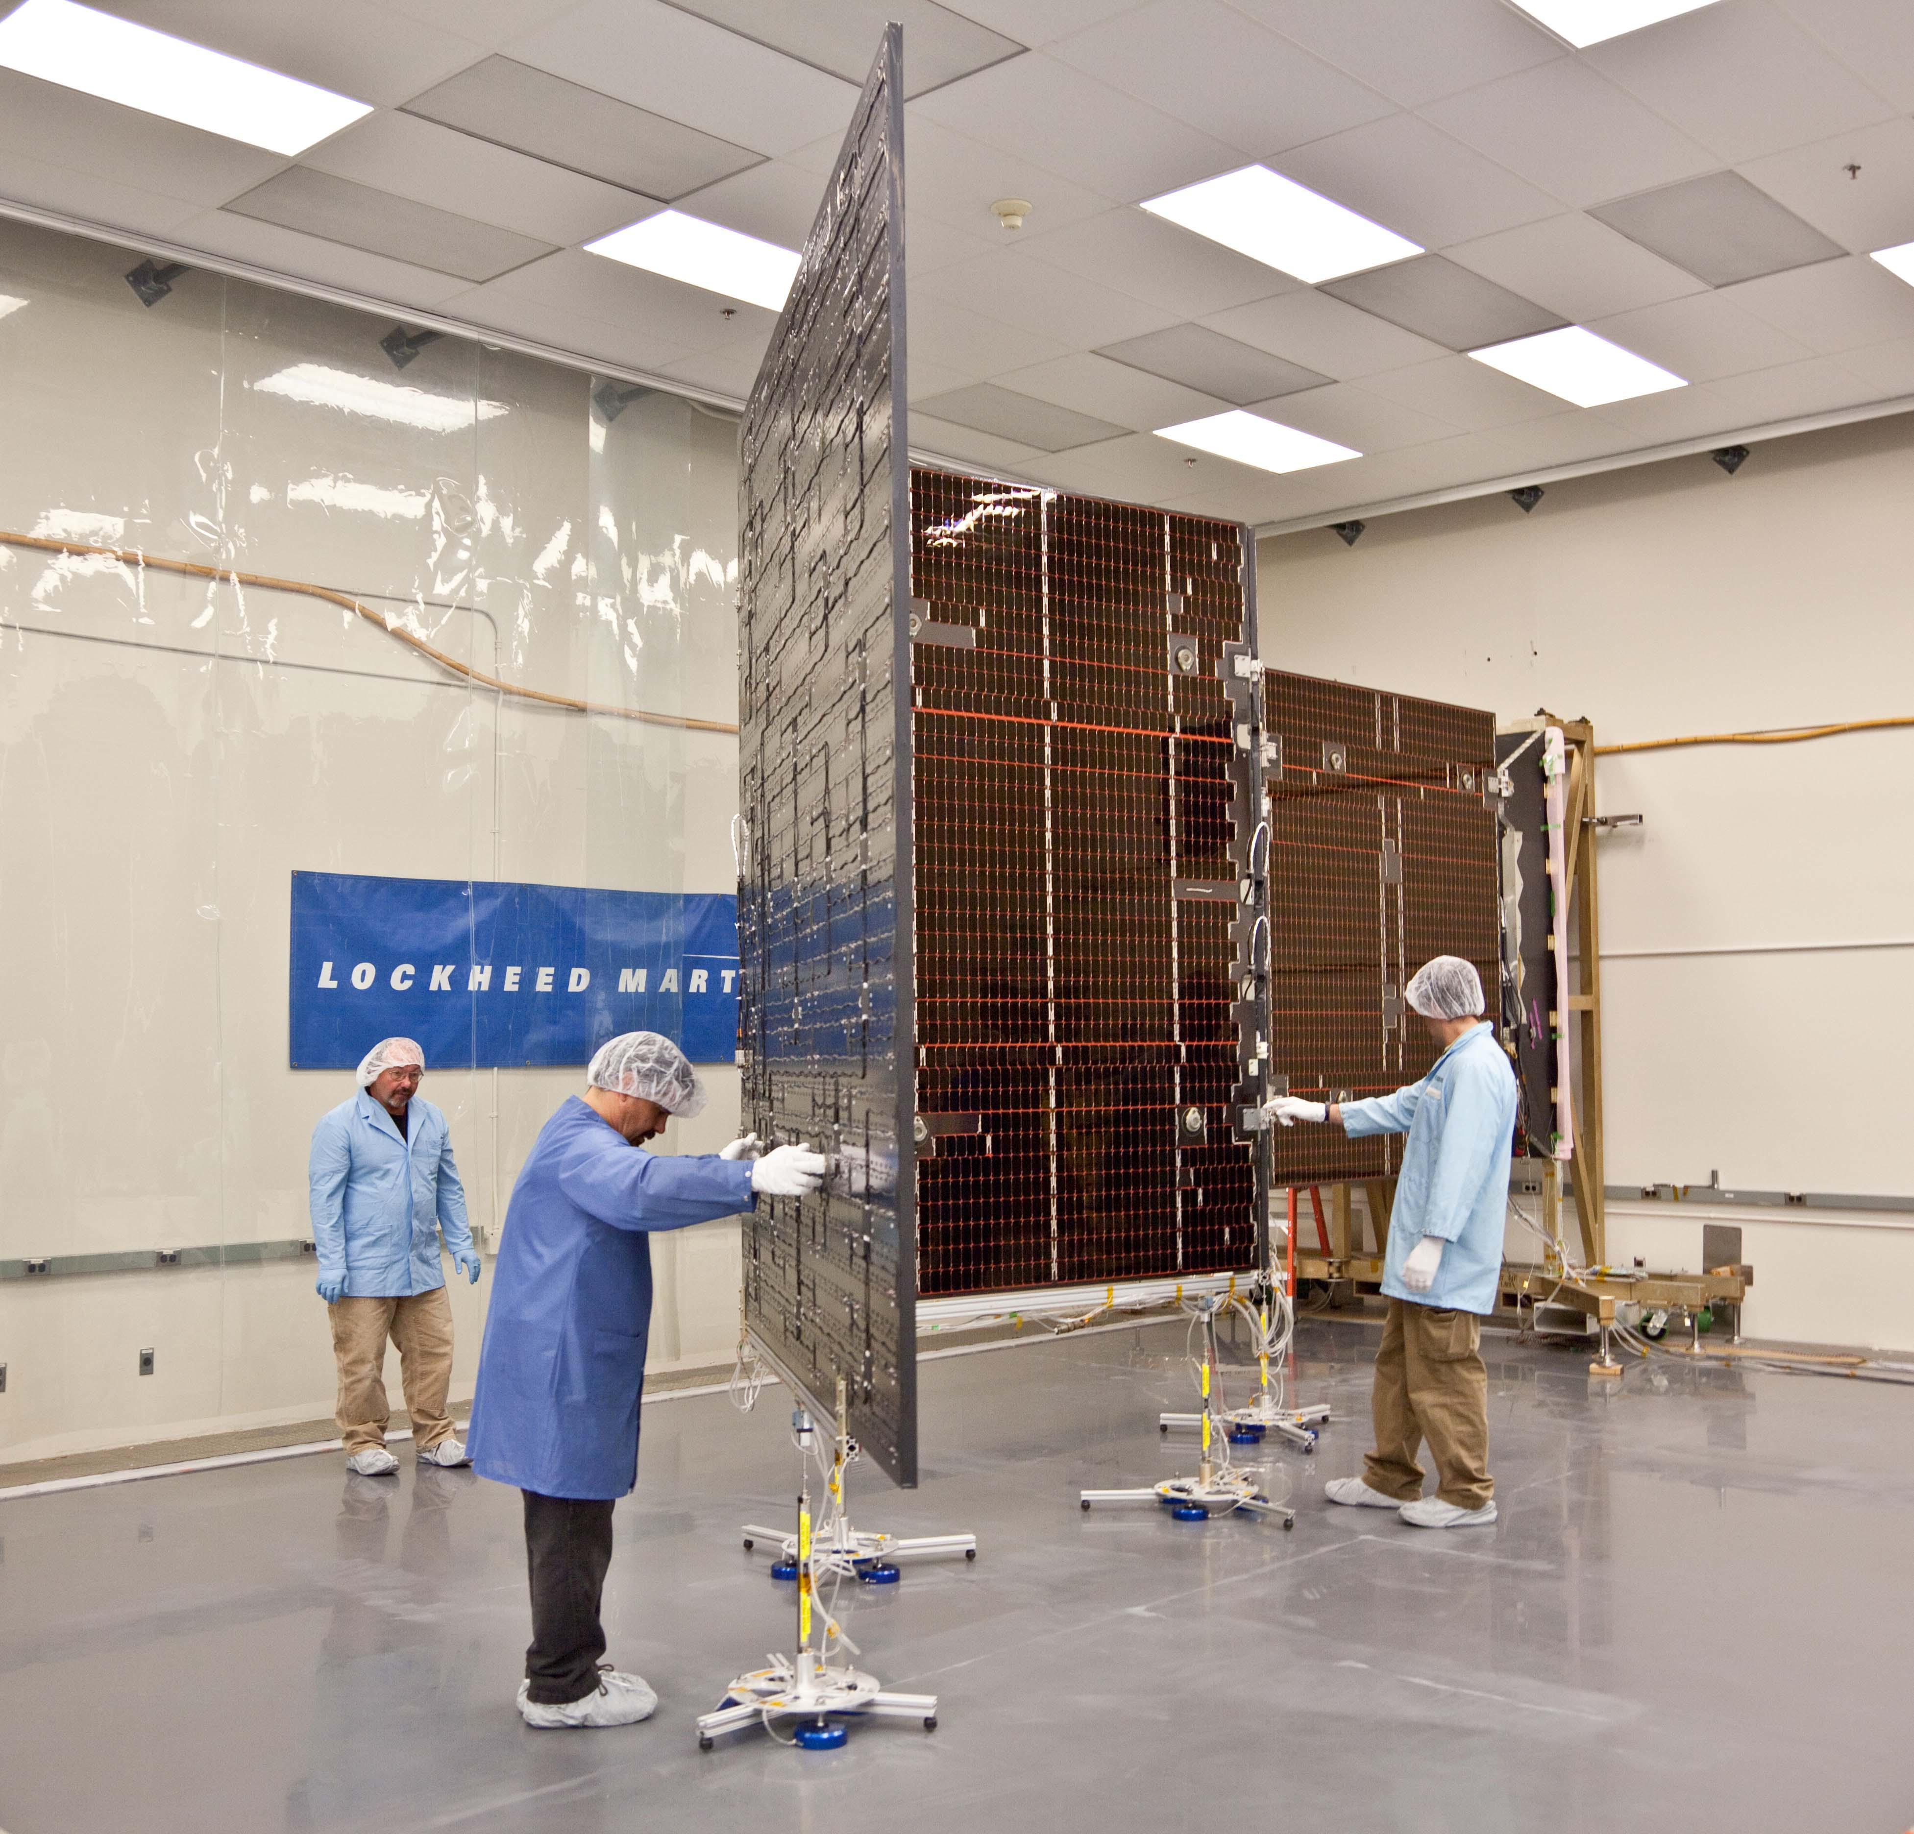
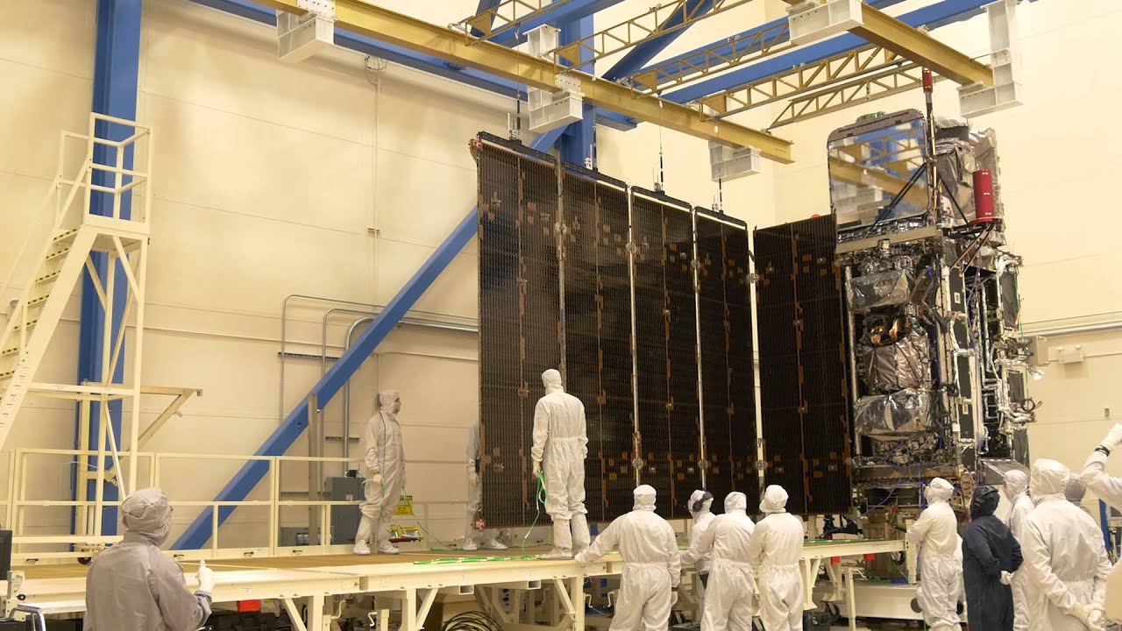
Solar Array Deployment: Juno & GOES-R

Slide 24
Vibration Testing
Demonstrates:
Ability of the vehicle to endure the low-to-mid frequency (0-100 Hz) launch environment
Verify expected modes and damping
Detects manufacturing and workmanship errors stimulated by low-to-mid frequencies
Approaches:
Sinusoidal Sweep
Random
Sine Burst/Shock
→Perform low-level sine sweeps before and after a random/burst to verify no changes in response
Notes:
Sinusoidal Sweep: sweeps from low to mid-level frequencies at a levels based on expected interface acceleration levels from modelling
Random: derived to approximate sine vibration of launch vehicle, used with a force-limiting approach to limit loads
Sine Burst/Shock: simulated (or actual) shock used to create a static load to verify strength spacecraft/structure Lots of energy at many frequencies at once.
→Typically perform low-level sine sweeps before and after a random/burst to verify no changes in response
Types of Vibration Tests
Sine (Sinusoidal) Vibration Test
Purpose: Simulate low-frequency, steady vibrations caused by engine thrust oscillations, gimbal motions, and stage separation events.
Typical Range: 5–100 Hz.
Use: Identify resonant frequencies and verify that structural natural frequencies meet margin requirements.
Data Collected:
Frequency response (modes, resonances).
Amplification factors (Q-values).
Random Vibration Test
Purpose: Simulate broadband, high-frequency energy produced by rocket engine combustion and aerodynamic turbulence.
Typical Range: 20–2000 Hz (sometimes up to 2500 Hz).
Test Input: Power Spectral Density (PSD) profile in g²/Hz, integrated to a specified overall RMS acceleration (e.g., 10 g RMS).
Use: Primary qualification and acceptance test for most spacecraft components.
Outcome: Ensures mechanical integrity, verifies mounting methods, and screens for workmanship defects.
Shock (Pyroshock) Test
Purpose: Simulate high-frequency transients from stage separation, pyrotechnic devices, or deployment mechanisms.
Frequency Range: Up to 10–20 kHz.
Use: Ensures sensitive electronics and optical instruments survive shock loads.

Slide 25
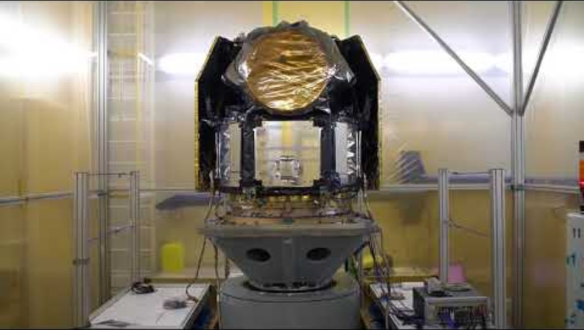
Vibration Testing – Sine Sweep

Slide 26
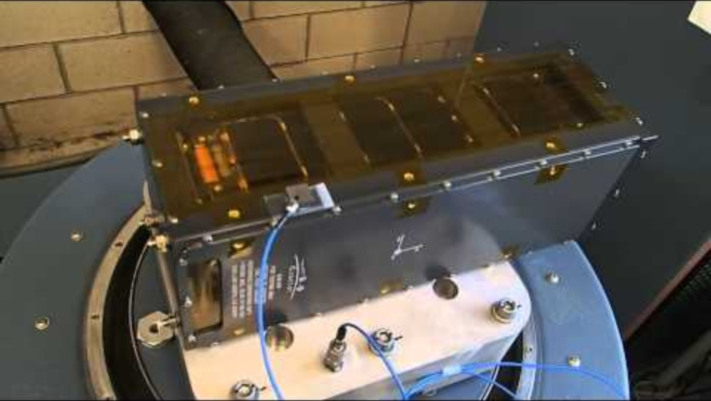
Vibration Testing - Random

Slide 27
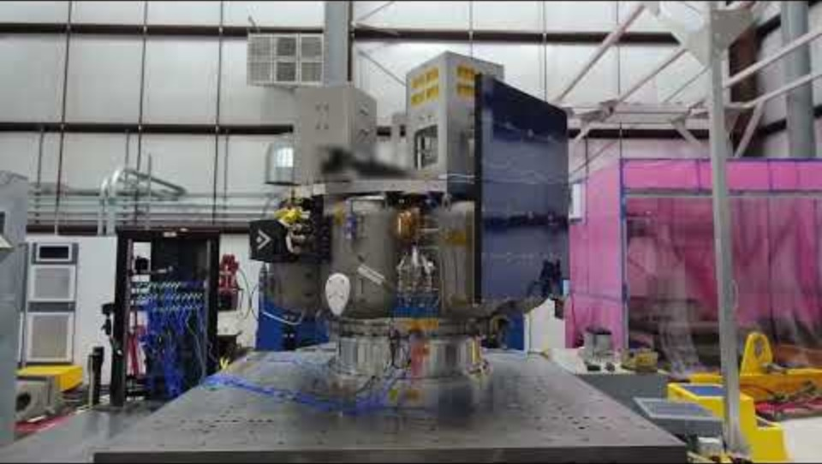
Vibration Testing – Sine Burst

Slide 28
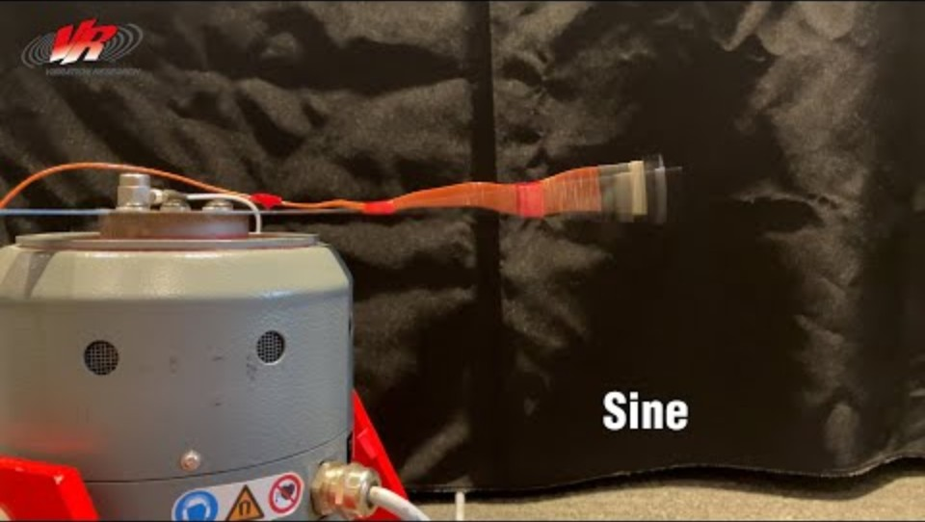
Vibration Testing - Comparison

Slide 29
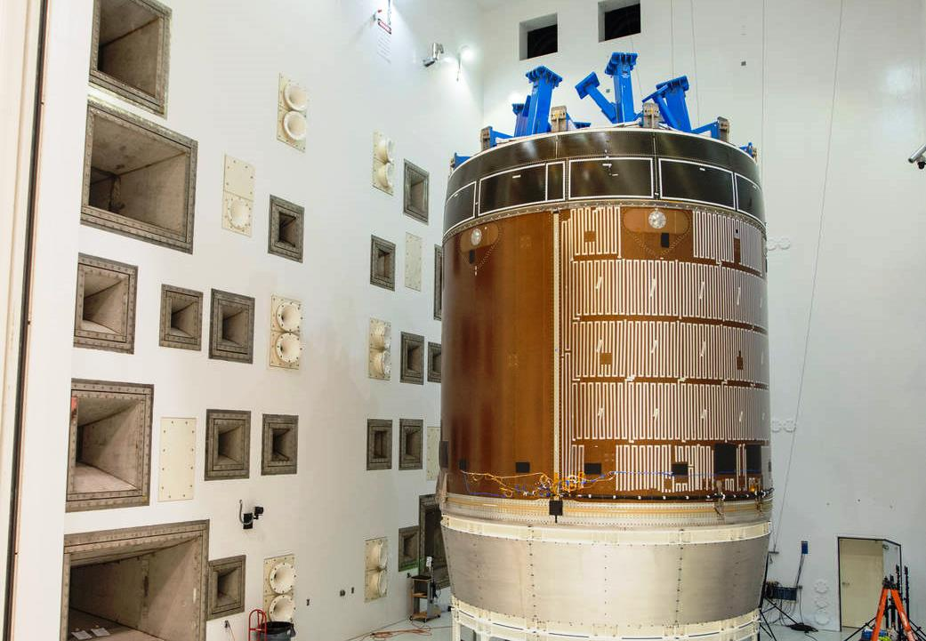
Acoustic Testing
Demonstrates ability of the vehicle to endure high-frequency acoustic environment during launch and ascent
Detects manufacturing and workmanship errors stimulated by higher frequencies
Acoustic Chamber (Orion Service Module)
Notes:
Acoustic Vibration Test (Reverberant Chamber)
Purpose: Simulate sound pressure levels (SPL) inside the payload fairing during launch.
Frequency Range: 20–10,000 Hz.
Environment: Conducted in a large acoustic chamber using high-power speakers.
Use: Test fully integrated spacecraft or large assemblies that cannot be mounted on a shaker table.

Slide 30
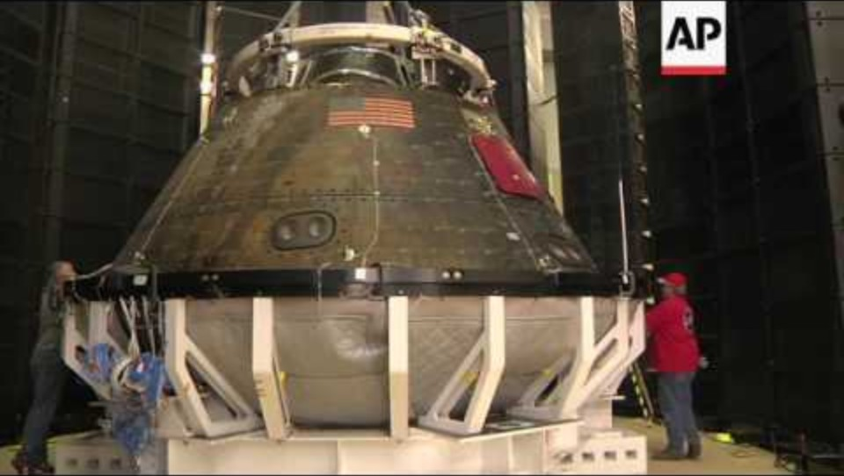
Acoustic Testing

Slide 31
Thermal Tests
Thermal Balance Test
Provides the data necessary to verify the analytical thermal model and demonstrates the ability of the vehicle TCS to maintain specified temperature limits of all units for various operational scenarios
Can be combined with TVAC
Thermal Vacuum Test (TVAC)
Demonstrates ability of vehicle to meet design requirements and establishes thermal design margin and vehicle performance under TVAC conditions and temperature extremes
Detects material, process and workmanship defects that would respond to thermal vacuum and thermal stress conditions
Notes:
Purpose
Spacecraft thermal testing verifies that the vehicle can survive and operate within the extreme temperature ranges and vacuum conditions of space. It ensures that:
All subsystems remain within allowable temperature limits.
Thermal control hardware (heaters, radiators, MLI, coatings) performs as designed.
The spacecraft functions properly during hot and cold extremes.
Space Thermal Environment
In orbit, spacecraft experience rapid heating and cooling as they enter and exit sunlight.
No air convection — only radiation and conduction transfer heat.
Temperatures can range from –180 °C (shadow) to +150 °C (sunlit).
Thermal testing reproduces this environment on Earth to verify design margins and control logic.
Types of Thermal Tests
1. Thermal-Vacuum (TVAC) Test
Purpose: Simulates space vacuum and temperature extremes.
Environment: Chamber pumped to <10⁻⁵ torr; walls act as blackbody radiators.
Process:
Spacecraft placed inside chamber.
Heaters and cold shrouds cycle temperatures through expected mission extremes.
Operate spacecraft in both hot and cold cases.
Outcome: Confirms system performance, leak integrity, and thermal balance.
2. Thermal-Balance Test
Purpose: Verify the thermal model (e.g., SINDA/FLUINT or Thermal Desktop).
Process:
Apply steady-state boundary conditions.
Compare measured hardware temperatures to model predictions.
Adjust model correlations (< ±3 °C typical).
Outcome: Validated thermal model for flight prediction and analysis.
3. Thermal-Cycle (Non-Vacuum) Test
Purpose: Screen components for thermal fatigue and workmanship defects.
Environment: Ambient-pressure chamber; repeatedly cycles between temperature extremes.
Application: Common for electronics boxes or subsystems before integration.
Instrumentation & Monitoring
Thermocouples / RTDs: Measure key locations on structures, electronics, and radiators.
Pressure gauges: Confirm vacuum integrity.
Heater controls: Maintain desired profiles.
Data logging: Continuous temperature, power, and functional telemetry monitoring.
Common Issues
Poor thermal contact between hardware and mounting fixtures.
Sensor calibration drift or wiring errors.
Chamber contamination (volatile residue on optics).
Incomplete correlation between model and test data.

Slide 32
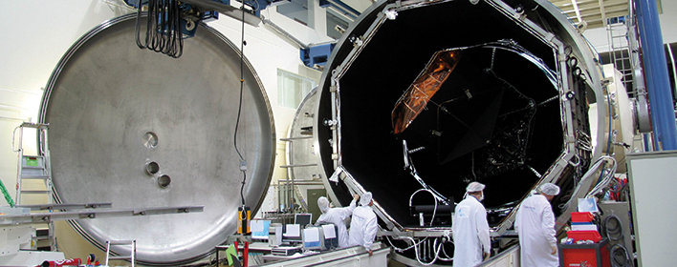
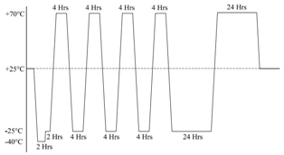
Thermal Vacuum Test
Notes:
Test facility: Thermal/Vacuum Chamber
Types of Tests
Hot/Cold Soak
Thermal Cycling
Sun Cage
Test objectives
Verify the S/C can function in the thermal/vacuum environment of space
Characterize S/C performance under nominal and extreme thermal/vac conditions
Validate thermal modeling results

Slide 33
Bake-Out
Not an environmental test per se but can be done as part of the same test campaign:
Bake-out
Facility: vacuum oven
Objective
Clean and/or verify cleanliness of S/C by putting it at elevated temperature (~40C) in vacuum for some number of hours
Record pressure changes or use cold fingers, witness plates to determine presents or extent of outgassing
Notes:
Bake-Out Test
Purpose: Remove volatile contaminants (moisture, outgassing compounds) before flight.
Process:
Heat spacecraft or parts in vacuum for 24–72 hours.
Collect outgassed materials on witness plates for contamination measurement.
Critical for: Optical systems, detectors, and clean payloads.

Slide 34
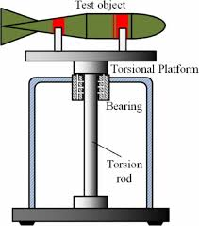
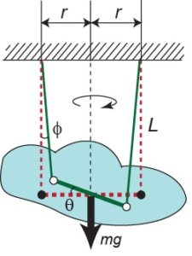
Mass Properties Testing
Torsion Pendulum
Verify spacecraft:
Mass
Center of Mass
Moment of Inertia
Bifilar Pendulum
Notes:
1. Mass Measurement
Method:
Use precision scales or load cells under each mounting point.
Sum the readings to determine total mass.
Accuracy: ±0.1% or better for spacecraft-level tests.
Considerations:
Include flight configuration (panels stowed or deployed).
Subtract fixtures and mounting adapters from total.
2. Center of Gravity (CG) Measurement
Purpose: Verify actual CG against predicted location.
Methods:
Single-axis balance: Rotate spacecraft on knife-edge or bearing until balanced.
Three-point weighing: Use multiple load cells and geometry equations to calculate CG in 3D.
Accuracy: Typically within ±1 mm for small satellites, ±5 mm for large spacecraft.
Applications:
Ensures proper alignment with launch vehicle interface.
Prevents unwanted torques during separation or spin-up.
3. Moment of Inertia (MOI) Measurement
Purpose: Verify rotational inertia used for ADCS design.
Common Methods:
Bifilar Pendulum: Suspend spacecraft on two wires, measure oscillation period → compute inertia.
Trifilar Pendulum: Adds third wire for measuring cross-axis coupling.
Torsion Pendulum: Twist spacecraft and measure restoring torque.
Accuracy: ±2–5% typical, depending on test geometry and damping.
------------------------------------------------------------------------------------------------------------------------------------------
Measuring a Satellite’s Moment of Inertia (MOI)
A satellite’s moment of inertia (MOI) is typically measured using torsional pendulum methods or inertia measurement tables before launch. These tests determine how the spacecraft resists angular acceleration about its principal axes.
$$τ=Iα$$
where
$τ$= applied torque
$I$= moment of inertia
$α$= angular acceleration
Accurate MOI is critical for attitude determination and control system (ADCS) design because control algorithms (reaction wheels, magnetorquers, thrusters) rely on the spacecraft inertia matrix.
1. Torsional Pendulum Method (Most Common)
Principle
The spacecraft is suspended from a thin torsion wire. When twisted and released, it oscillates.
The oscillation period depends on the spacecraft’s inertia.
$$T=2π\sqrt{\frac{I}{k}}$$
where
$T$= oscillation period
$I$= moment of inertia
$k$= torsional stiffness of the wire
Rearranging:
$$I=\frac{kT^{2}}{4π^{2}}$$
Procedure
Mount the spacecraft on a fixture attached to the torsion wire.
Twist slightly and release.
Measure oscillation period using sensors.
Repeat about multiple axes to determine the inertia tensor.
Advantages
Very accurate
Simple physics
Common for small satellites and CubeSats
2. Bifilar Pendulum Method
Another common approach uses two parallel suspension wires.
The spacecraft oscillates rotationally between the wires.
$$I=\frac{mgd^{2}T^{2}}{4π^{2}L}$$
where
$m$= mass
$g$= gravity
$d$= wire separation
$L$= wire length
$T$= oscillation period
This method is often used when torsion wires cannot support the spacecraft mass.
3. Inertia Measurement Table (IMT)
Large satellites use motorized inertia measurement systems.
Procedure:
Spacecraft mounted on precision bearings.
Apply a known torque with a motor.
Measure resulting angular acceleration.
Using
$$I=\frac{τ}{α}$$
These systems can measure:
principal moments $I_{x},I_{y},I_{z}$
cross products of inertia $I_{xy},I_{xz},I_{yz}$
4. Why MOI Measurement Is Critical
The spacecraft inertia matrix:
$$I=\left[\begin{matrix}I_{x} & −I_{xy} & −I_{xz} \\ −I_{xy} & I_{y} & −I_{yz} \\ −I_{xz} & −I_{yz} & I_{z}\end{matrix}\right]$$
is required for:
ADCS simulations
reaction wheel sizing
control law design
maneuver planning
Even 5–10% errors in inertia can significantly affect control performance.

Slide 35
Example Integration & Test Flow
Spacecraft Assembly & Integration Complete
Inspection
Full Functional Test
1
2
3
Vibe
Acoustic
EMC
Pressure/Leakage Test
7
6
5
4
Shock/Deployment
Pressure/Leakage Test
Thermal Balance/TVAC
8
9
10
Inspection
Full Functional Test
Pressure/Leakage Test
13
12
11

Slide 36
Test Like You Fly (TLYF)
Concept of testing a system in the same manner in which it will be used in an operational manner
Very complicated to implement
General considerations:
Flight command & telemetry tested with actual ground software
Fault condition detection
Mode/state changes
Off-nominal condition responses
Post-environmental test repairs tested
Flight-like stimuli for responses, appropriate simulators
Extended test time (DITL, WITL)
Primary and redundant hardware
Exercise at high, low, nominal voltages
Consider how to capture data that verifies that test objectives are met!

Slide 37
FalconSAT Notes
Capabilities-based vs. Requirements-based development
FS Xtra Solar Panels..
Bottom Line → Attention to Detail!

Slide 38
Extra Material

Slide 39
Clean Rooms
Clean Rooms
Eliminate/control particulate (dust) that may damage or degrade sensitive parts or components
Help control static discharge
Provide a controlled environment for sensitive AIT operations
Focus the minds of engineers performing sensitive AIT operations
Classification
“Class 10,000” means < 10,000 particles greater than 0.5 µm per cubic foot
Standard environment is 70°F and 45% RH
Uses
Mechanical assembly: N/A
Semiconductor manufacturing: Class 0.1—10
Optical assembly: Class 100
Electronic assembly: Class 10,000
S/C assembly & testing: Class 100,000

